Slide 1
DisCourse:
A flexible platform to talk about course selection
Team 14 | Hazel Dunn, Matthew Chandra, Nicole Pupp, Seraphina Yong, Kimney Nguyen
Notes:
(10 sec) Seraphina
Today we’ll be presenting the user research and ideation process for DisCourse, a flexible platform for talking about course selection.

Slide 2
Our initial idea
Create a course-reviewing platform that fulfills student needs.
Notes:
(~11-13 sec) Nicole?
Our initial idea was to come up with a platform for reviewing and sharing information about courses, since most other existing platforms are more focused professor-based reviews or not course-centered.

Slide 3
USER STUDY PROTOCOL
OBTAIN CONSENT
INTERVIEW PROCESS
SURVEY
CONCLUSION
We interviewed graduate and undergrad students of differing majors, totalling 6 interviews. Each was asked the same set of questions.
Background questions: 5-10 mins
Usage/Experience Questions: 25-35 mins
Prior to interview process, we informed participants with the procedures of our research in a consent form. They were familiarize with their rights and the data we were collecting to fully understand their participation.
A survey was sent to an additional 28 graduate and undergraduate students at the U of M. Users were presented with the consent form, then asked both multiple choice and open ended questions.
Before ending the interview, participants were reminded of their rights and given the opportunity to ask final questions and convey final points, then thanked for their participation.
Notes:
30 kimney
Gathering user information we decided to use survey and interview methods. We target both undergrad and graduate students obtaining consent before their participation of course. We gathered 28 survey responses which consisted of multiple choice and short answer questions. We then carried out 6 interviews that gathered student background and usage/experience info. Concluding our interviews, we gave our participants an opportunity to bring up final questions or points, reminded them of their rights, and thanked them for their participation.

Slide 4
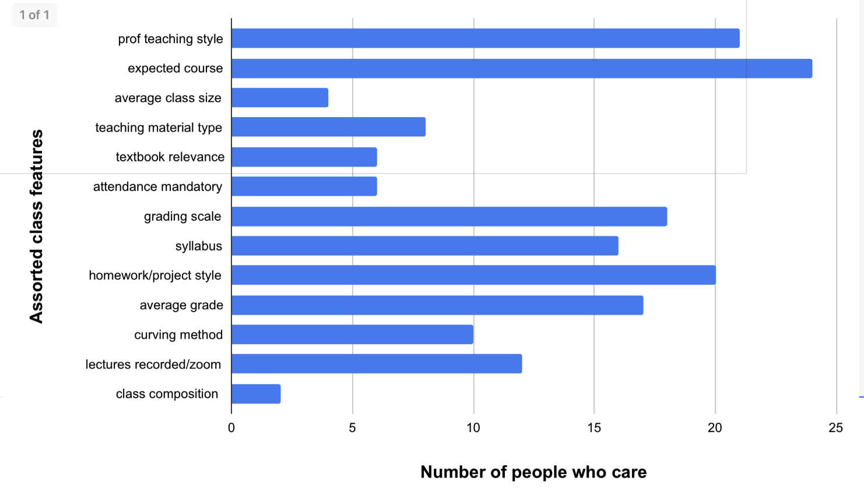
What class features do students care about?
Notes:
15 matt
From our survey, we found that characteristics students care about when searching for courses are:
The professor’s teaching style
Expected course workload
Grading scale
Syllabus
Homework/Project style
Average grade received by students in the course.

Slide 5
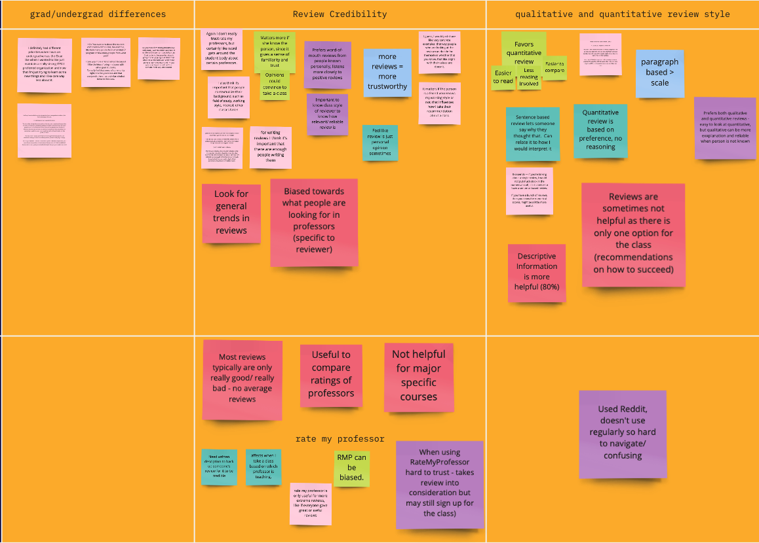
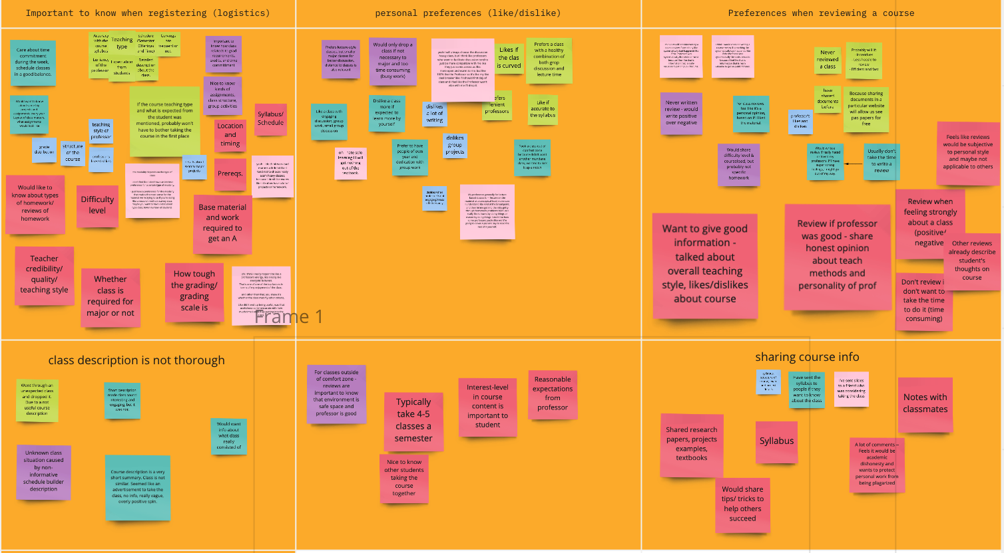
USER STUDY CLUSTERS
User Goals:
See reviews that are valuable specifically for them
Exists enough reviews to have more information
3. Understand the review based on the reviewer’s personal traits
4. Better understand the number ratings given by the reviewers.
Notes:
30 matt
We then analyzed through each of our interview transcriptions for open codes to form our user study clusters. These clusters were the basis our user goals which are as follows:
User wants to see reviews that are valuable for their individualized preferences
User want enough reviews to exist in order to have more useful information
User wants to understand what the review means in terms of the reviewer’s unique traits
User wants to have better understanding of what each reviewer’s number ratings mean

Slide 6
DESIGN IMPLICATIONS
Provide context
of reviewer
Accommodate
individual differences
Provide background information of students who are writing reviews
User Goal: Understand reviewer’s personal traits
Accommodate for subsets of individual differences in class considerations/preferences
User Goal: See personally valuable reviews
Motivate
review writing
Clarify the meaning of ratings vs. words
Provide motivators for completing reviews
User Goal: More reviews = more information
Clarify relationships between qualitative and quantitative parts of a review
User Goal: Understand number ratings
Notes:
1:30 minutes (Hazel)
We came up with these design implications, and I’ll explain how they address the user goals that we mentioned in the last slide.
One of our design implications is to provide context of the reviewer, or the background information about the reviewer, along with the review.
This helps readers understand what the reviews mean in terms of that individual, for example: if a math major says a math class is hard, vs. if an english major said so, that may hold very different meaning due to the reviewers experience.
It is also important to design the platform to motivate review writing, because users found that having more existing reviews for a class gave the information more value.
We will also accommodate for individual differences in the attributes people care about in a class, as one of the user goals was to see reviews that contain the kind of information they care the most about. We also saw a little bit of that in all of the different class attributes from the survey earlier.
We also aim to design ways for the review to display class ratings and descriptive information that make clear what a reviewer really means by giving that number rating.

Slide 7
IDEATION
1. Allow reviews to be filtered by feature
2. Suggestions for reviews : “comment on professor’s teaching style”, workload?, how to succeed, etc.
3. Option for liking/disliking reviews
4. Option for commenting on reviews
5. Provide a way to share documents
6. Way to ask professor about what you can share
7. Section for sharing tips or tricks about classes
8. Information on grade received in course of the reviewer
9. To start using the app, someone has to submit 2 reviews (unless first year or transfer)
10. Ability to make profiles
11. Background on learning style, major, etc.
12. Show the date of review
13. Main statistics at top of app homepage
14. Average rating shown next to name of class
15. Average grade received in class near the top
16. People can check off on their profile what “class features” they’re interested in
17. Tags or categories visualized at the top of the review
18. Indicator to show statistical strength of quantitative ratings (e.g. red if very few reviewers, green if more reviewers)
19. Require include instructor of course in review
20. Awards for achieving a certain number of likes on your review
21. Have people fill out background information about themselves when they make a profile
22. Background info on a person working style
23. Different color themes for the app
24. Being able to see more information if you are a review writer
25. Sorting reviews by department on home part of interface
26. Sorting reviews by class level (undergrad, graduate)
27. Sorting reviews by program requirements/liberal education requirements
28. Sorting reviews by average rating
29. Put a link to ScheduleBuilder for the course
30. Let people create schedules on the app
31. Let people save classes to their own thing
32. Allow people to rate difficulty level on the review
33. Visualize background information on the review
34. Quote of the day from a review can be highlighted on homepage or profile
35. Suggest friends on app to users who have similar background profiles
36. Reviewers should explain why they took a class
37. Make certain fields optional on a review to make writing easier
38. Certain descriptive fields are still required so there are words in the review
39. Link to Reddit for class info
40. Link to rate my professor for class info
41. Review can include student’s impression of class composition, especially for grad students
42. Indicator on the class and review to show what semesters the class is offered
43. Enable friending between user profiles
44. Include icons for different areas of study (e.g. STEM)
45. Allow people to make profile pictures
46. Q&A platform for asking questions about classes
47. Allow people to follow certain reviewers
48. There is a way to contact a reviewer to ask about their review (e.g. DMing)
49. Make awarded reviewers visibly indicated on the review
50. Put most-liked reviews at the top
51. Sort reviews for a class by certain criteria
52. People can use their rewards to buy stuff
53. Users get awards for writing a lot of reviews
54. Indication of average GPA of the reviewer on the reviewer (if they want to show it)
55. People can say in the review what grade they got in a class
56. Rating a review by different characteristics
57. You can upvote or downvote comments on a review
58. People can say how much time they spent on a class per week in the review
59. Option to share the review with a link
60. Bookmark, star, or save reviews
61. Organize saved reviews by self-defined categories
62. Highlighting on home page the classes with the most reviews
63. Highlighting most-liked classes in a section/list
64. Highlighting most-disliked classes in a section/list
65. Allow live-streaming to answer questions or talk about a class live
66. Send reviews to other people in the app
67. Include courses you’ve taken on the student’s background profile
68. Including on profile what you care most about getting out of a class (e.g. grade, interest)
69. Include attach feature in DMS to enable attaching syllabus/documents
70. Suggest friends to people who have written review for the same class
71. Include summary of class from ScheduleBuilder (official school course description)
72. Sharing hobbies/interests on profile
73. Recommend a class to friends or followers
74. You can only make friends on the app if you write reviews
75. Certain features become unlocked if you write more reviews
76. Unlocked features can contain customizing profile
77. Can send virtual presents to reviewers that you like
78. Top reviewers get presents
79. Allow the option to review as a guest user
80. For guest reviews make sure to display lack of information saliently
81. If reading reviews as a guest you can only see certain features
82. Highlighted classes are only available to those who have profiles
83. Let professors to make profiles on the app
84. Professors can respond to reviews or comments for the class
85. Professors can post syllabus to the class
86. Verify professors on professor profile
87. Allow student users to be anonymous
88. Create username to remain anon while giving background information
89. Users can filter who can see their background info, including for professors
90. Verify user identity using real info but don’t display this in the app
91. Encourage or prompt people who write more concrete reviews
92. Provide questions for reviewers when they don’t know what to write
93. Have a mod for the board to manage potentially inappropriate information
94. Be able to ban reviewers
95. Disable mentioning students of classes by name in the review
96. Give warnings to people who wrote inappropriate reviews and let them see this on their profile
97. Send notifications at the end of classes to remind/prompt users to write reviews
98. Send notifications shortly before the registration period to remind/encourage users to check out reviews
99. Clubhouse audio -- interactive podcast thing for anonymous discussion of a class
100. Top reviewers are nominated to become potential moderators for the review platform
Notes:
15 kimney
Being as creative as possible, we used our design implications to come up with a total of 100 ideations as shown here.

Slide 8
IDEA CLUSTERS
Allow Diverse Profiles
Student, Guest, Professor, Anonymous, Mod
Create User Profiles for Background Information
Learning Style, Major, Previous Courses Taken
Visualize Crowdsourced Information in a Homepage Summary
Popular Reviews/ Classes, Avg Class Rating & Grade
Encourage/ Reward Users to Write Reviews
Awards for Popular Reviews, Unlock more Features
Allow Users to Share & Network with Each Other
Friending, Messaging, Q&A Platform
Enable Interaction with Reviews
Liking/ Disliking Reviews, Creating Schedules, Bookmarking Classes
Require Specific Information in Review
Instructor, Class Composition, Grade, Reason for Taking - Provide Questions/ Suggestions for Reviewers
Enable Notifications for Reviewing/ Reading
Reminders at End of Semesters, Before Registration
Include Links to External Resources
Reddit, RateMyProfessor, ScheduleBuilder
Notes:
30 Nicole
From ideation were determined the following 9 clusters.
Allowing diverse profiles, creating profiles with background information, visualizing popular information on the homepage, encouraging users to write reviews, allowing users to share and network with one another, enabling interaction with reviews, requiring certain information in a review, enabling notifications, and including links to other resources.

Slide 9
FINAL DESIGN IDEAS
Allow users to create diverse profiles with individualized information
Accommodate different types of reviewers (registered, guest, professor)
Provide reviewer background of working style, major, and interests
Create a homepage summary of review trends
Highlight most-liked, most-reviewed classes in a ranked list
Show average ratings and class grades along with statistical strength
Reward users for writing reviews
Award badges for reviews with the most likes, or for writing more reviews
Unlock more reviews or course information if you write more reviews
Require reviews to contain specific, concrete information
Reviewers are required to mention the top class attributes from our survey
Provide prompts to help reviewers explain the reasons behind a rating
Enable user interaction with reviews
Users can upvote/downvote reviews, or comment to provide more information
Professors with profiles can comment on reviews to clarify (reviewers remain anonymous)
Notes:
(1:45-2 min) Seraphina
After voting on our idea clusters, we came to the final ideas. Here I’ll explain each of them with some examples that also tie back into the design implications.
So, going from left to right:
We’ll let users create different kinds of profiles that contain individualized information about them. For example, student reviewers can create registered profiles that contain their background information, such as working style, learning style, and area of study. We will also allow people to review as guests, which can serve as more motivation for review writing for those who don’t want to go through the trouble of filling in all that profile information. Of course in this case we would also make it clear on their review that we have no background info about this person, to remind readers.
We’ll also create a summary of trends in the reviews that the users can read, such as highlighting most-reviewed or most-liked classes in a ranked list, and showing the statistical strength of different average ratings for classes. This works to help clarify the relative value of quantitative and qualitative data.
To motivate review-writing, we will have active rewards for writing more reviews, or for writing reviews that get more likes from people. We can also unlock more course information for those more active review writers.
We will require reviews to contain specific information by providing concrete prompts to reviewers, helping them explain the reasons behind a rating. This works to address diverse individual differences in class considerations by prompting people to talk about those specific considerations.
Lastly, we’ll enable users to interact with the reviews, such as upvoting, downvoting, or commenting. Other students or professors can comment to clarify issues mentioned in a review — and this works to better contextualize the information provided in the review.
Users creating diverse profiles:
Accommodate for subsets of individual preferences about classes, because it makes it easier for students to understand other students’ backgrounds
Helps motivate students to write reviews since they don’t necessarily have to formally register to write one, just that the review would show that there’s no background information for this reviewer
Summary of review trends
Helps clarify the value of quantitative and qualitative review data
Reward users for writing reviews
Provides motivation for writing reviews
Concrete review information
Address individual differences in class considerations
Enable user interaction with reviews
Goes back to the design implications of providing more diverse backgrounds and experiences to better contextualize the review

Slide 10
Thanks for listening!
Notes:
So that’s all we have for you today, and thanks for listening!

Slide 11
Fonts & colors used
This presentation has been made using the following fonts:
Aldrich
(https://fonts.google.com/specimen/Aldrich)
Didact Gothic
(https://fonts.google.com/specimen/Didact+Gothic)
#ffe599
#4c64d8
#ff952b
#e9f3ff
#d5e6fc
#a8cfff
#00004d

Slide 12
DEFINITION OF CONCEPTS
VENUS
JUPITER
MERCURY
Venus is beautiful and is the second planet
Jupiter is a giant and the biggest planet
Mercury is the closest planet to the Sun

Slide 13
—SOMEONE FAMOUS
“This is a quote, words full of wisdom that someone important said and can make the reader get inspired.”

Slide 14


FEATURES OF THE TOPIC
You can write about the topic here
You can write about the topic here
You can write about the topic here
You can write about the topic here

Slide 15
100,000,000
44,000,000
56,000,000
Illiterate youth in the world
Illiterate young men
Illiterate young women

Slide 16


DEMO
Despite being red, Mars is a cold place. It’s full of iron oxide dust, which gives the planet its reddish cast
You can add your own multimedia content here. Delete this image and insert the video in its place

Slide 17
DID YOU KNOW THIS?
MERCURY
MARS
SATURN
Mercury is the closest planet to the Sun
Despite being red, Mars is a cold place
Saturn is the ringed one and a gas giant
VENUS
JUPITER
NEPTUNE
Venus is the second planet from the Sun
It’s the biggest planet in the Solar System
Neptune is the farthest planet from the Sun

Slide 18
PROBLEM
SOLUTION
Mercury is the closest planet to the Sun and the smallest one
Jupiter is a gas giant and the biggest planet in the Solar System

Slide 19
USER STUDY PROTOCOL
Consent Form informing participants of interview process
Jupiter is the biggest planet
Consent
Survey
Interview
Conclusion
Sent
Venus has a beautiful name

Slide 20
AWESOME WORDS

Slide 21
OVERVIEW
MERCURY
NEPTUNE
JUPITER
VENUS
It is the farthest planet from the Sun
It is the biggest planet in the Solar System
Venus has a beautiful name, but it is hot

Slide 22
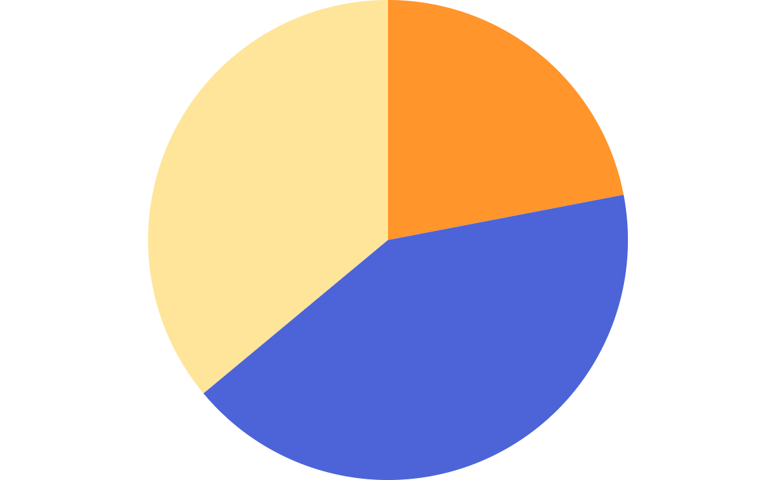
THIS IS A GRAPH
NEPTUNE
45%
Neptune is the farthest planet from the Sun
15%
VENUS
Venus has a beautiful name, but it’s hot
40%
MERCURY
Mercury is the closest planet to the Sun
To modify this graph, click on it, follow the link, change the data and paste the new graph here

Slide 23
ASSIGNMENT
 | VENUS | SATURN | EARTH
MASS | 0.08 | 2.50 | 1.15
DIAMETER | 5.95 | 9.82 | 1.05
GRAVITY | 1.02 | 2.08 | 1.13

Slide 24


A PICTURE IS A WORTH A THOUSAND WORDS

Slide 25
13,012,400
Big numbers catch your audience’s attention

Slide 26
WHAT IS THIS TOPIC ABOUT?
JUPITER
NEPTUNE
Jupiter is a gas giant and the biggest planet
Neptune is the farthest planet from the Sun
VENUS
MARS
Venus has a beautiful name, but it is hot
Despite being red, Mars is actually a cold place

Slide 27
EDUCATION ICONS PACK

Slide 28
ALTERNATIVE RESOURCES

Slide 29
RESOURCES
Did you like the resources on this template? Get them for free at our other websites.
Photos
Globe and books near laptop
Kids and teacher posing while wearing a medical mask
Happy teenager making notes near laptop
Vectors
Online certification with laptop
Online certification concept
Online certification concept
Online certification for college graduates
Icons
Education Icon Pack

